Slide 1
RHIZOSTOMA CBAM-ResViT-UNet+: OPTIMIZED HYBRID ATTENTION-TRANSFORMER MODEL FOR BUILDING EXTRACTION FROM HIGH-RESOLUTION SATELLITE IMAGERY
DATASET NAME : WHU BUILDING DATASET
DATASET LINK : https://www.kaggle.com/datasets/sengulgs/whu-building-dataset/data

Slide 2
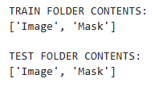


Slide 3
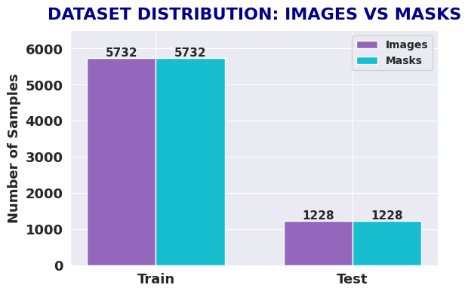

Slide 4
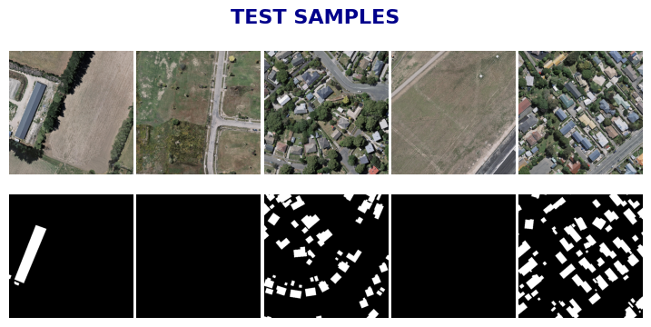

Slide 5
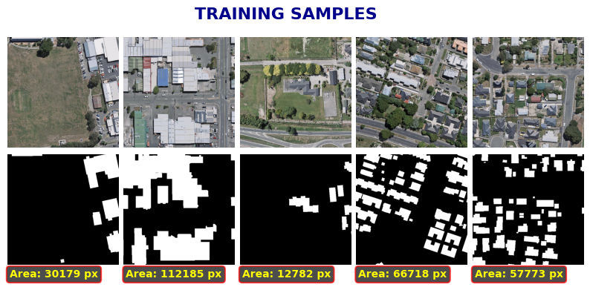

Slide 6
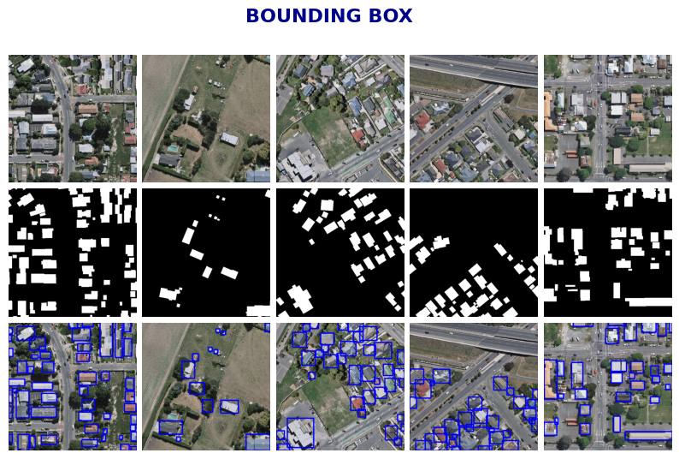

Slide 7
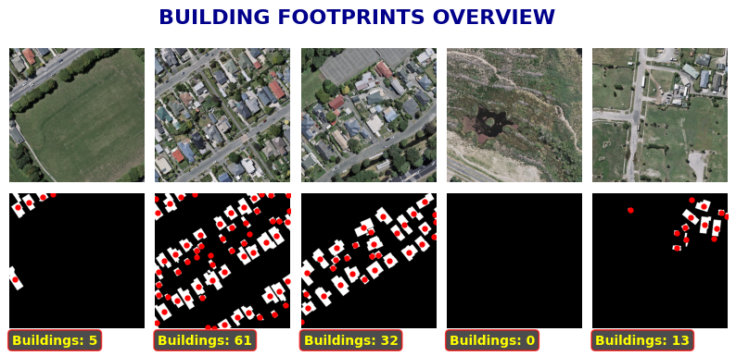

Slide 8
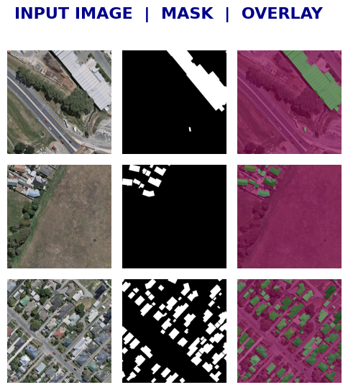

Slide 9
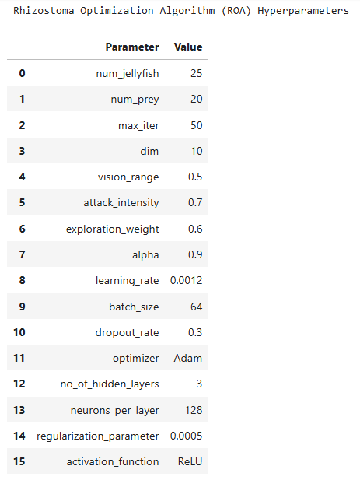

Slide 10
Algorithm: Rhizostoma Optimization Algorithm (ROA)
1. Initialize the population (jellyfish positions) X_i (i = 1, 2, ..., N)
randomly within the search space [LB, UB].
2. Evaluate the fitness for each jellyfish X_i using the objective function.
3. Identify the best solution (Best_X) and its corresponding fitness value.
4. Set iteration t = 1.
5. While t <= Tmax:
6. For each jellyfish X_i:
7. Update motion control factor (MCF) based on current iteration.
8. IF rand < MCF (Exploration Phase - Moving within the swarm):
- Update position using Levy Walk (LW) or similar random walk
to explore new regions.
ELSE (Exploitation Phase - Searching for food):
- Update position using Simulated Annealing (SA) or
Fast Simulated Annealing (FSA) based on best solution.
END IF
9. Keep the new positions within the search bounds [LB, UB].
10. Evaluate the fitness of the new position.
11. Update the best solution (Best_X) if the new position is better.
12. t = t + 1
13. End While
14. Return Best_X

Slide 11
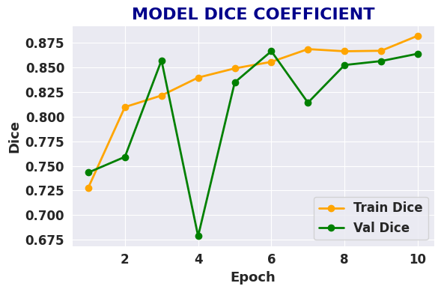

Slide 12
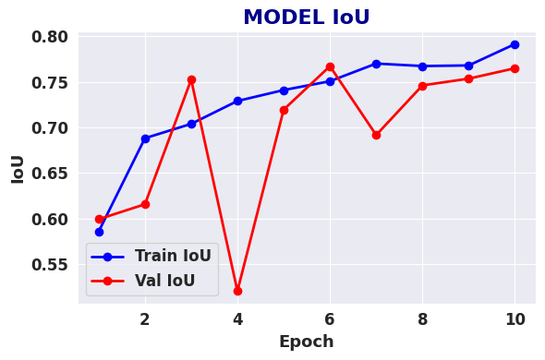

Slide 13
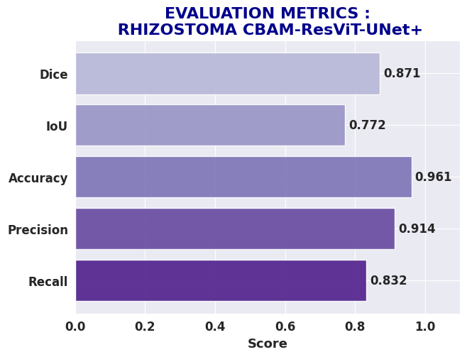
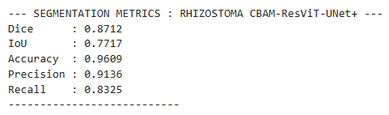

Slide 14
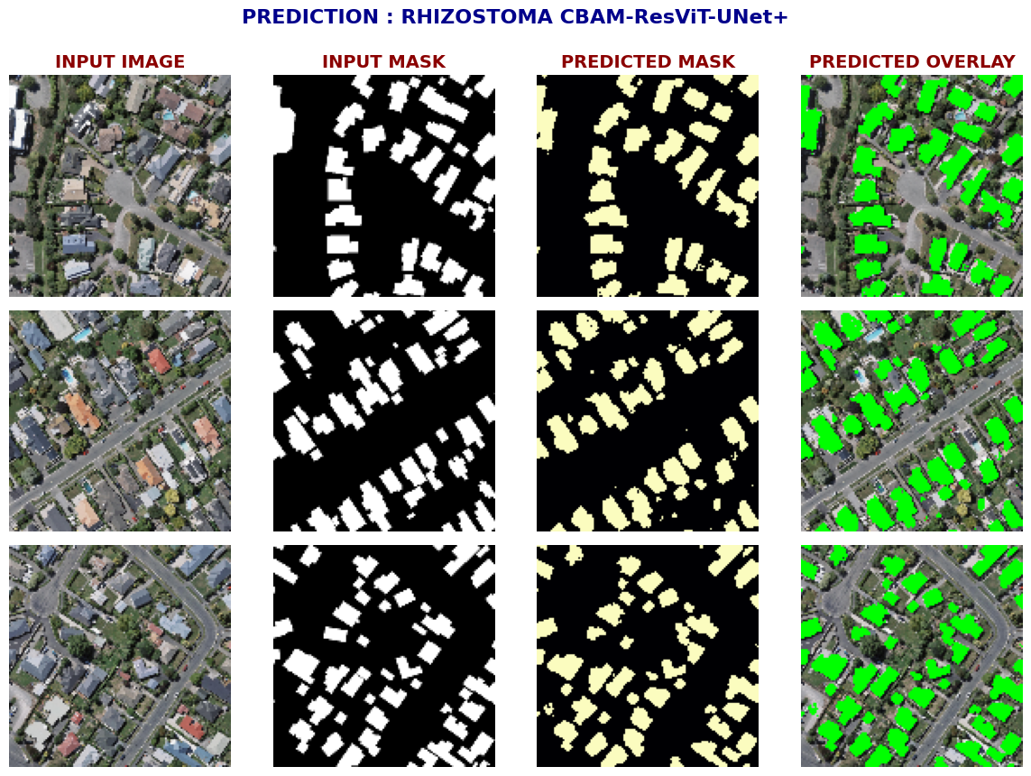

Slide 15
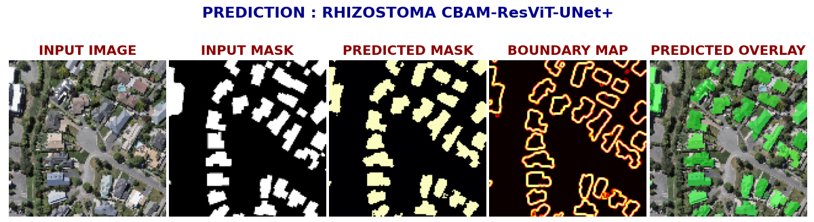
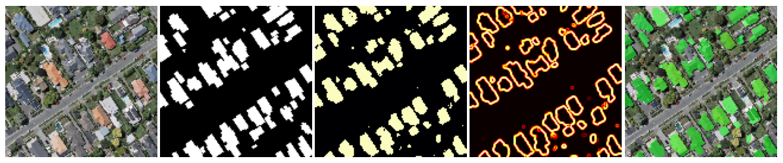
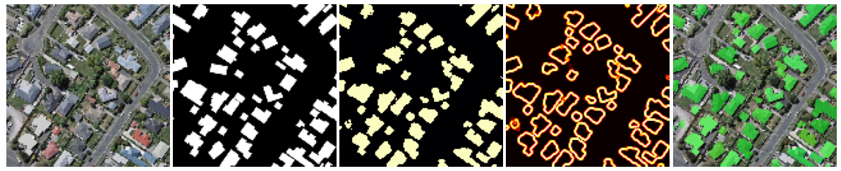

Slide 16
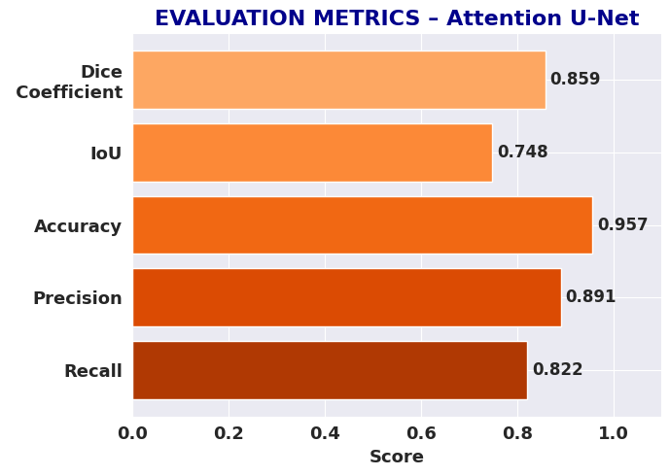
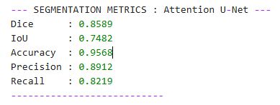

Slide 17
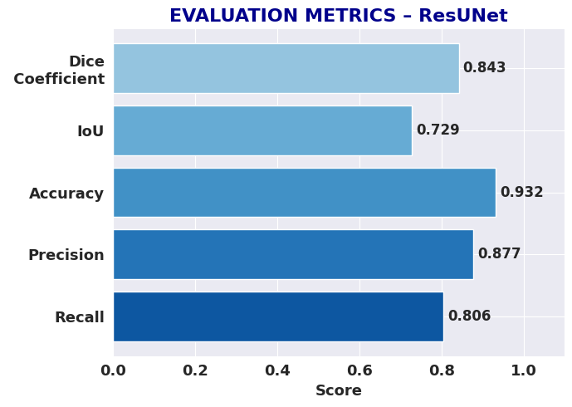
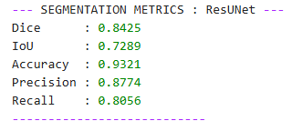

Slide 18
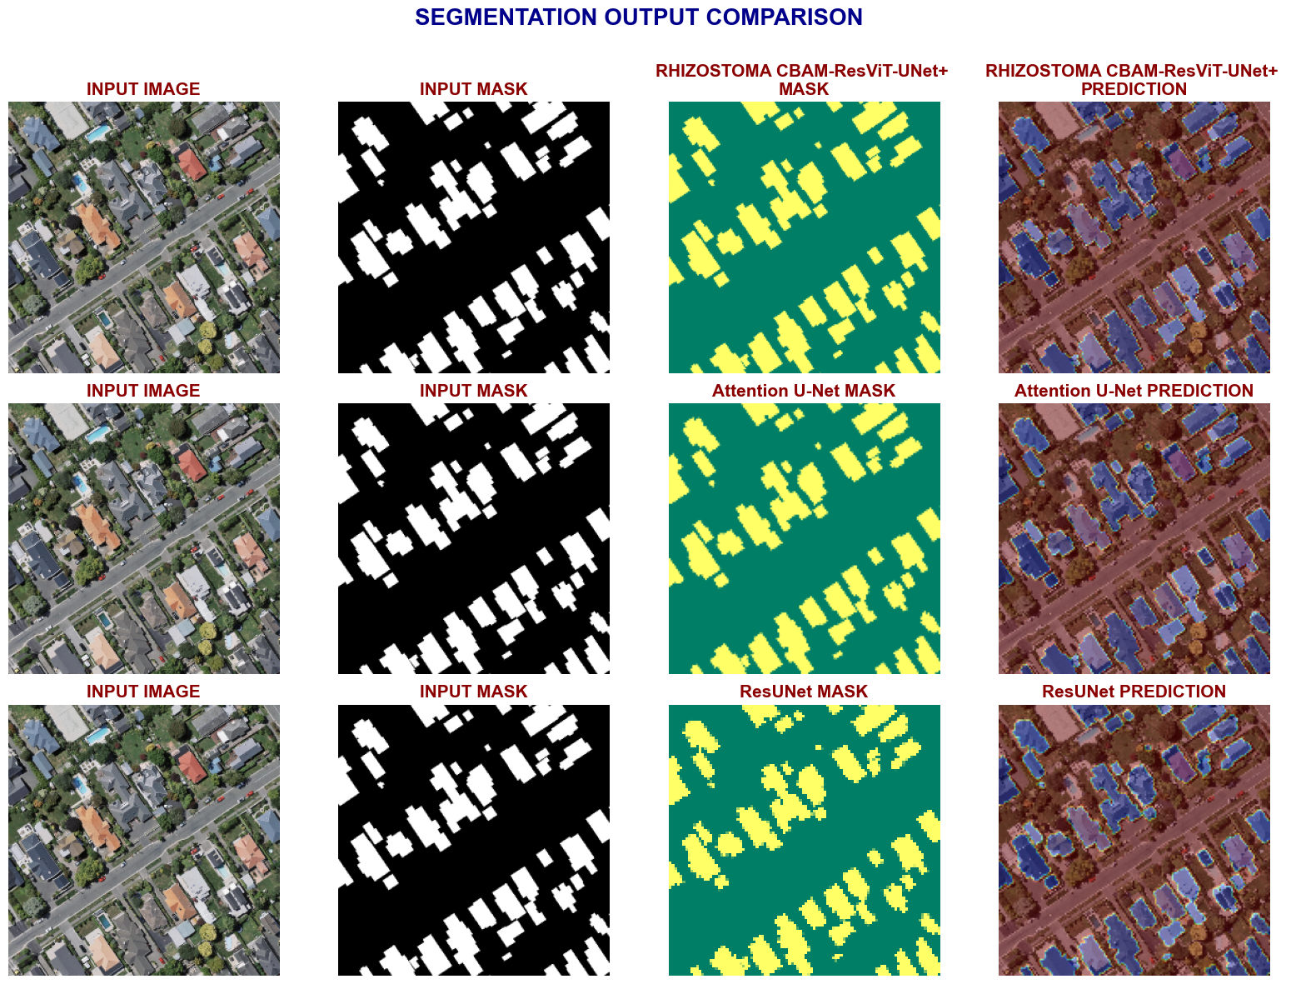

Slide 19
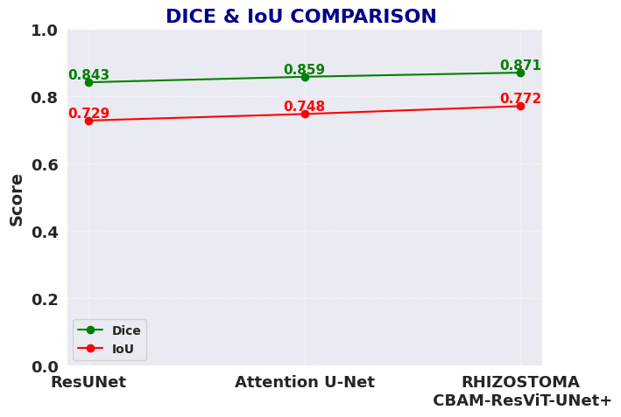

Slide 20
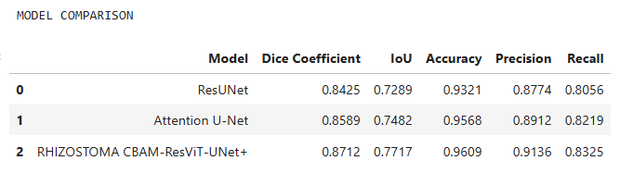

Slide 21
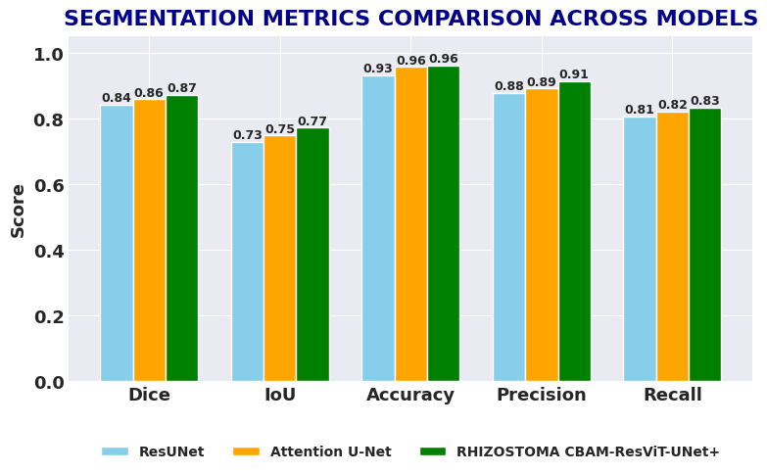

Slide 22
